Slide 1
Input Devices
Prepared By
Mehedi Hasan Imran
Lecturer, BAUET
Dept. of ICE

Slide 2
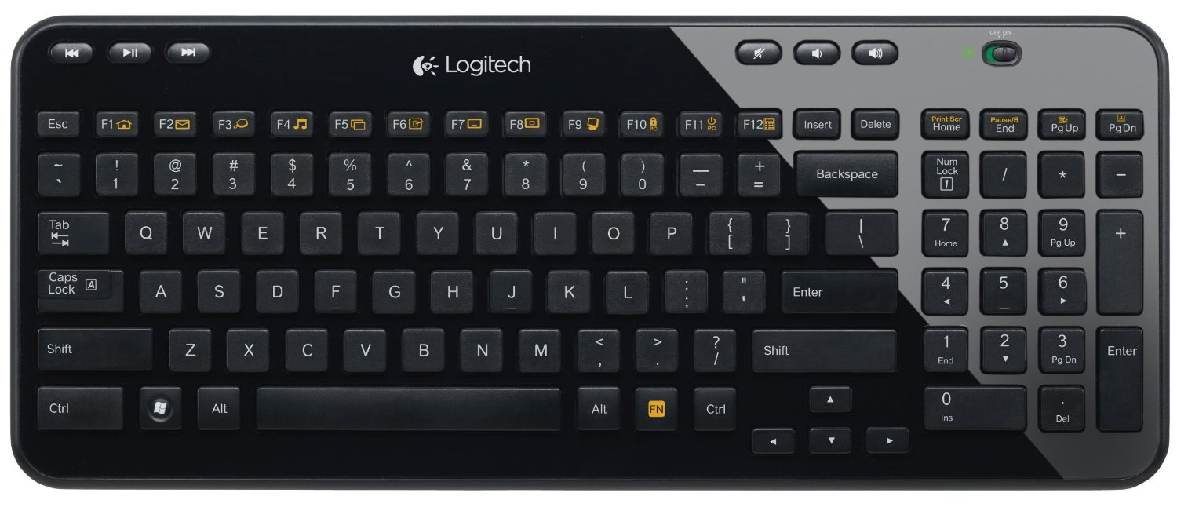
Keyboard
The invention of the modern computer keyboard began with the invention of the typewriter. Christopher Latham Sholes patented the typewriter that we commonly use today in 1868. Keyboard is the most common and very popular input device which helps to input data to the computer.
Keyboards are of two sizes 84 keys or 101/102 keys, but now keyboards with 104 keys or 108 keys are also available for Windows and Internet.

Slide 3
S. No | Keys & Description
1 | Typing Keys These keys include the letter keys (A-Z) and digit keys (09) which generally give the same layout as that of typewriters.
2 | Numeric Keypad It is used to enter the numeric data or cursor movement. Generally, it consists of a set of 17 keys that are laid out in the same configuration used by most adding machines and calculators.
3 | Function Keys The twelve function keys are present on the keyboard which are arranged in a row at the top of the keyboard. Each function key has a unique meaning and is used for some specific purpose.
4 | Control keys These keys provide cursor and screen control. It includes four directional arrow keys. Control keys also include Home, End, Insert, Delete, Page Up, Page Down, Control(Ctrl), Alternate(Alt), Escape(Esc).
5 | Special Purpose Keys Keyboard also contains some special purpose keys such as Enter, Shift, Caps Lock, Num Lock, Space bar, Tab, and Print Screen.

Slide 4
Pointing Devices
The pointing devices are used to point or select anything on the screen using devices such as a mouse. These pointing devices are also called “Input devices.“
Examples of pointing devices
Below are examples of pointing devices that can be used on a computer.
Camera mouse
Computer mouse (shown in picture)
Finger on touch screen
Footmouse
J mouse
Joystick
Leap Motion

Slide 5
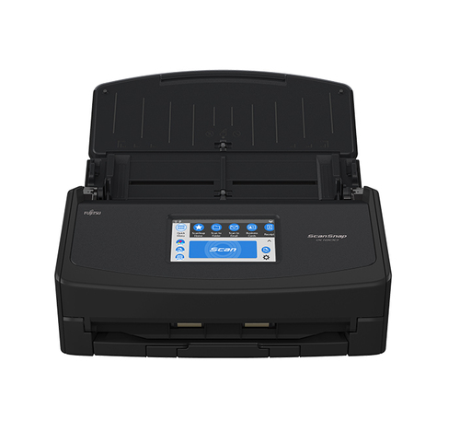
Scanning Devices
Scanner is an electronic device that uses light-sensing equipment to scan paper images (e.g., text, photos, and illustrations) and translate the images into data that the computer can then store, modify, or distribute.

Slide 6
Optical scanners
Optical scanners capture data using a beam of light. A light beam passes over an object and the image is analyzed by specialized software
Some examples of optical scanners
Optical Mark Readers/Recognition. (OMR)
OMR detects marks made on a piece of paper using ink or soft pencil, by passing an infrared beam over them. The computer then interprets the data input.
Optical Bar Reader/Recognition(OBR)
Used to capture data coded in lines of varying thickness known as barcodes or Universal Product Code(UPC). Barcodes holds manufacturer’s details and the product code but not price details because prices vary from one place to another.
Optical Character Reader/Recognition(OCR)
An OCR scanner is used to read typewritten, computer printed, or handwritten characters and transforms the images into a softcopy that can be manipulated using a wordprocessor. Today, a more advanced OCR scanner called a flat-bed scanner is used to capture pictures and real objects.

Slide 7
Magnetic scanners
Magnetic scanners are used to capture data written using magnetic ink or coded onto a magnetic strip. This device uses the principle of magnetism to sense the document characters, which have been written using magnetized ink. The ink is magnetized using particles of iron(II) oxide.
Common examples of magnetic scanners are, the Magnetic Ink Character Reader/Recognition (MICR), Magnetic Strip Readers (MSR) and card readers.

Slide 8
Monitors
Monitors, commonly called as Visual Display Unit (VDU), are the main output device of a computer. It forms images from tiny dots, called pixels that are arranged in a rectangular form. The sharpness of the image depends upon the number of pixels.
There are two kinds of viewing screen used for monitors.
Cathode-Ray Tube (CRT)
Flat-Panel Display
Cathode-Ray Tube (CRT) Monitor
The CRT display is made up of small picture elements called pixels. The smaller the pixels, the better the image clarity or resolution. It takes more than one illuminated pixel to form a whole character, such as the letter ‘e’ in the word help.
There are some disadvantages of CRT
Large in Size
High power consumption

Slide 9
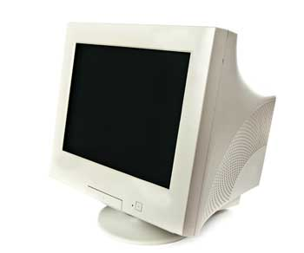
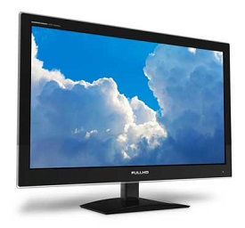
Flat-Panel Display Monitor
The flat-panel display refers to a class of video devices that have reduced volume, weight and power requirement in comparison to the CRT. You can hang them on walls or wear them on your wrists. Current uses of flat-panel displays include calculators, video games, monitors, laptop computer, and graphics display.

Slide 10
The flat-panel display is divided into two categories −
Emissive Displays − Emissive displays are devices that convert electrical energy into light. For example, plasma panel and LED (Light-Emitting Diodes).
Non-Emissive Displays − Non-emissive displays use optical effects to convert sunlight or light from some other source into graphics patterns. For example, LCD (Liquid-Crystal Device).
Printers
Printer is an output device, which is used to print information on paper.
There are two types of printers −
Impact Printers
Non-Impact Printers

Slide 11
Impact Printers
Impact printers print the characters by striking them on the ribbon, which is then pressed on the paper.
Characteristics of Impact Printers are the following −
Very low consumable costs
Very noisy
Useful for bulk printing due to low cost
There is physical contact with the paper to produce an image

Slide 12
Non-impact Printers
Non-impact printers print the characters without using the ribbon. These printers print a complete page at a time, thus they are also called as Page Printers.
These printers are of two types −
Laser Printers
Inkjet Printers
Characteristics of Non-impact Printers
Faster than impact printers
They are not noisy
High quality
Supports many fonts and different character size

Slide 13
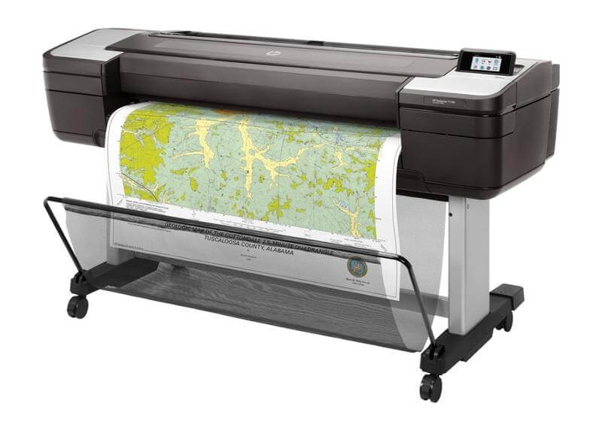
plotter
A plotter is a type of printer that prints vector graphics. It is a piece of computer gear that converts computer commands into paper line drawings. It draws a line with one or more automatic pens. Unlike a traditional printer, a plotter uses a pen, marker, pencil, or other writing tools to draw multiple rather than toner. It may also use vector graphics files or commands to draw continuous point-to-point lines.

Slide 14
Applications of Plotters
Draw charts
Computer-aided designs
Architectural Blueprints
Textile Printing
Banners and Billboards
Electric circuit layouts
Geographical layouts
Building plans
Line Art
projector
A projector is an output device that is capable of connecting to a computer, which may be an other option for a monitor or television in terms of displaying pictures to a large number of people. It takes images generated by a Blu-ray player or a computer and projects them onto a large surface like a wall or white screen. Projectors come in many shapes and sizes and are used in conditions like a classroom, home cinemas, office training or presentation sessions, etc. The projector looks like the below picture.

Slide 15
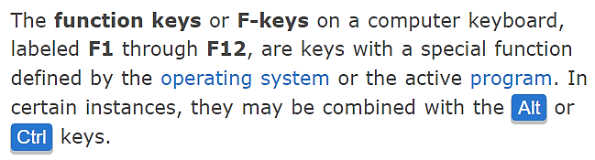
What are the F1 through F12 keys?
On some smaller keyboards and laptop computers, the F-keys may have a dedicated purpose, such as changing the screen brightness, the volume, or other device-specific functions. On these keyboards, there's an Fn key that you can hold down to toggle what the F-key does. See our Fn page for further information and help with using this key.

Slide 16
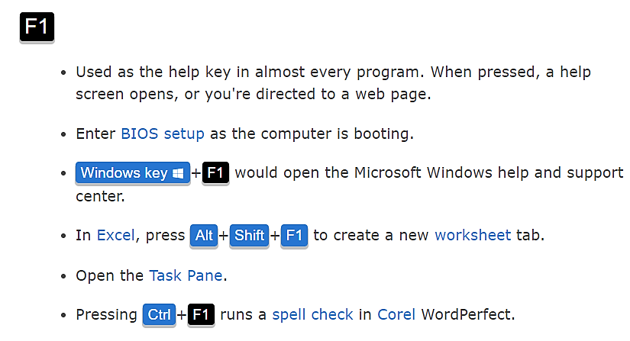

Slide 17
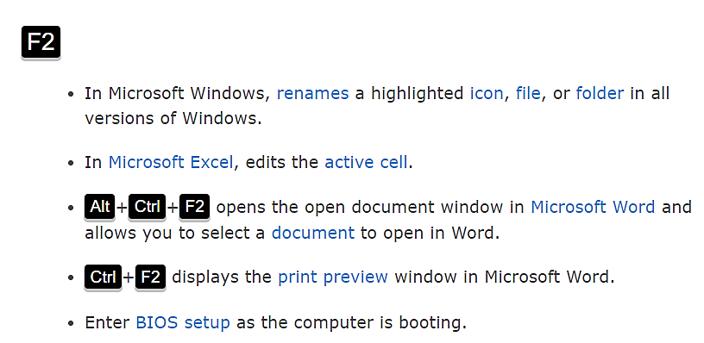

Slide 18
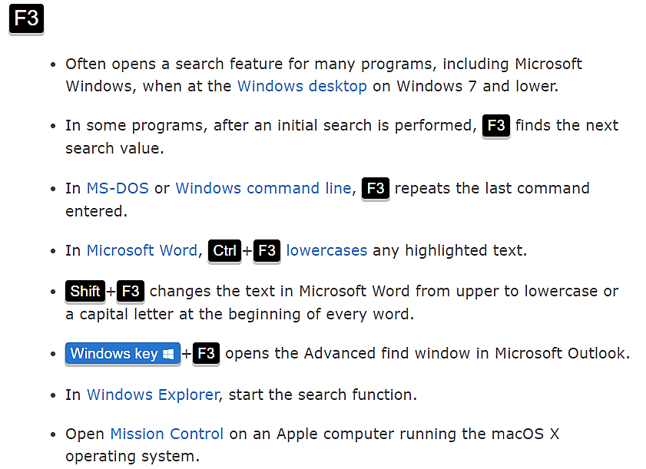

Slide 19
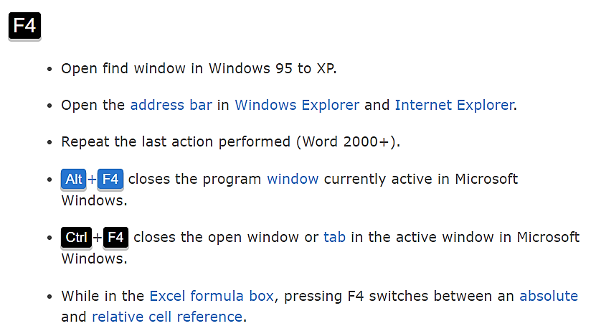

Slide 20
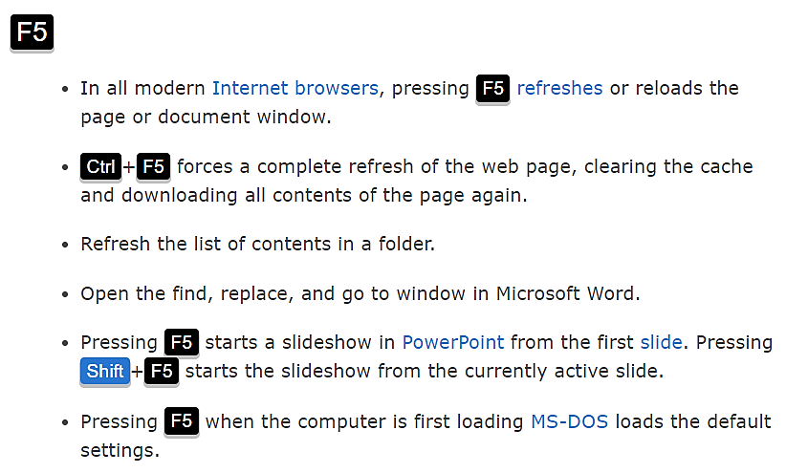

Slide 21
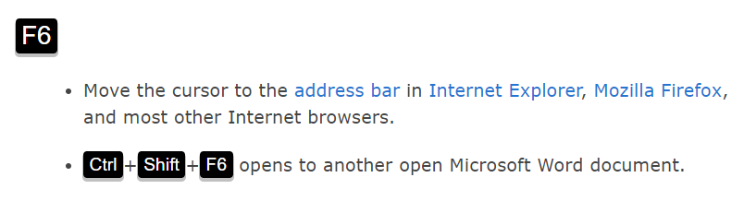
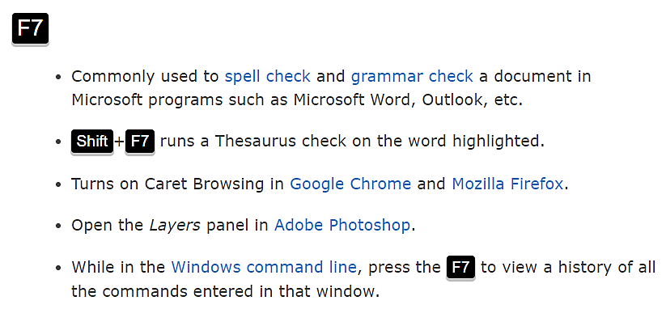

Slide 22
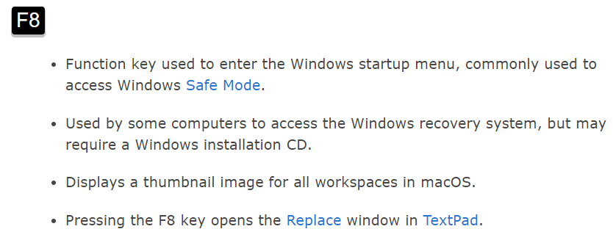
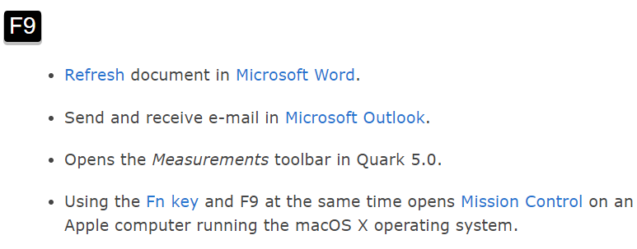

Slide 23
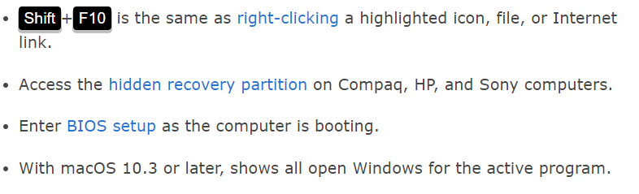
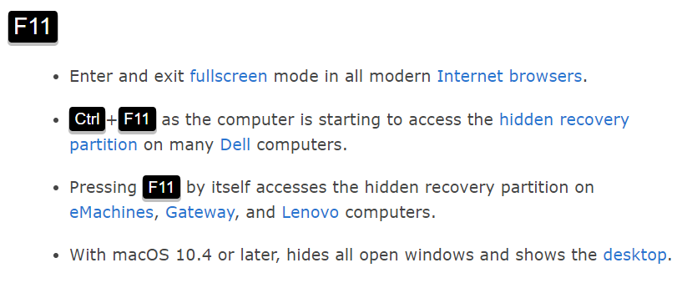

Slide 24
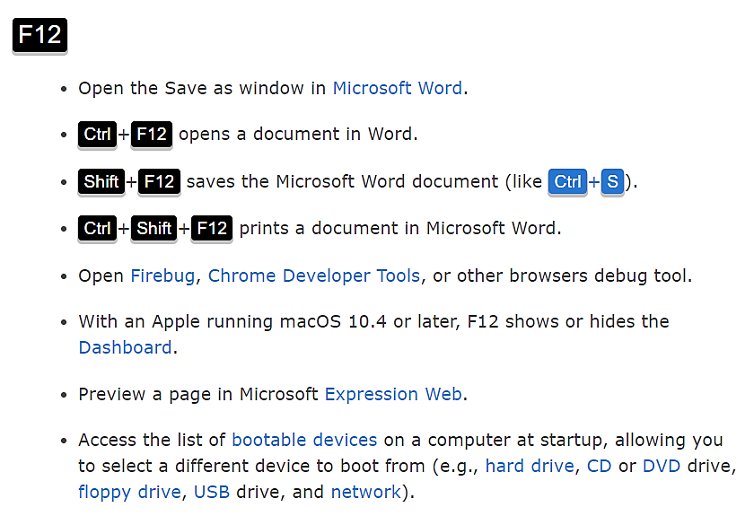

Slide 25
Questions
Explain keyboard history.
Describe different types of keys.
What is pointing device? List five pointing devices.
What is scanner? Explain types of scanner.
Explain monitors and its classification.
Explain the application of plotter.

